Slide 1
PowerPoint:
What’s the point?
Tools and Tips #2
For More Effective Teaching
Practice Slides
ICL Fall 2024
Read Gilgen

Slide 2

Hands on Exercises #2
Note: you can jump directly to the practice slide, but some instructional slides precede them, if you need review.
Tip: Click the “Slide Show” icon at the lower right to preview an edited slide
Tip: When playing the slide show, click the ICL logo at the lower right to return to this slide.
Objects/Layers (slide 6)
Modify text objects (slide 8)
Shrinking text (slide 10)
Copy/select multiple objects (slide 13)
Transitions (slide 15)
Continuous play (slide 16)
Animation & Animation Pane (slide 20 )

Slide 3
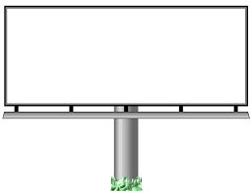
Objects & Layers
PowerPoint consists of “objects”
All objects are “layered” and positioned anywhere on slide
Graphic
Image
(Bottom Layer
Objects &
Layers
Text Box
(Top Layer)

Slide 4

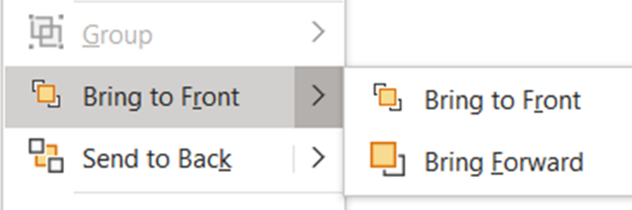
Objects & Layers
Right click an object to change layer position
Hold down shift key to click/select multiple objects; right click to group
Send object
To back
Backward
Bring object
To front
Forward
Objects &
Layers

Slide 5
Key/Click Options
To select more than one object:
  Shift+Click (hold down shift key and click)
To copy an object, or group of objects:
  Ctrl+Click (hold down Ctrl key and drag selected object)

Slide 6
Practice: Objects & Layers
Position the objects so words are on front of billboard
Group object into one layer
Center the grouped object.
Objects &
Layers

Slide 7
Text Objects
Text is always placed in “container” objects
  Title boxes
  Subtitle boxes
  Bullet boxes
  Text boxes
Inside Shapes

Slide 8
Practice: Modifying Text Objects
Edit Text on this slide
  title, bullets, shape
  Add bullet, and change level
Insert a text box, add text
Modify text (font/attributes)
Reposition/resize/modify boxes
Text in a shape

Slide 9
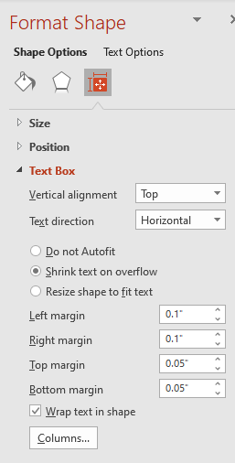

Shrinking Text
In bullet boxes, the text size automatically shrinks to fit size of box
Expand box (or delete some text) to make it fit
When the text shrinks as you add bullets,
click on the text, then click on the icon
at the lower left to turn off Autofit.
Format Shape/Size Size & Properites/TextBox
  This applies to any text box

Slide 10
Practice: Shrinking Text
Add another bullet or two here.
When the text shrinks as you add bullets, delete some text, or resize the text box.
If the Autofit button appears at the lower left, click it to turn off Autofit, then turn it back on.
Go to Shape Format, Size, Text Box, and try the options there.

Slide 11
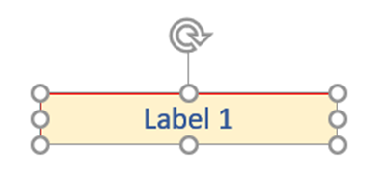
Consistent Text Box Format
Method 1: Copy text box
  Create first text box (e.g., one being used for a label)
  Select it, the hold down the Ctrl key and drag box to copy it to a new location
Label 1

Slide 12



Consistent Text Box Format
Method 2: Format Painter
  You already have a box you want to format
  Select box whose format you want to use
  From Home menu, select the Format Painter Brush
  Click on text box to change.

Slide 13

Practice Copy Objects
Use the mouse to rearrange these objects
Use Ctrl-drag to copy the text box
Edit the text box contents
Move and copy objects to point to the clown’s mouth
Hair

Slide 14
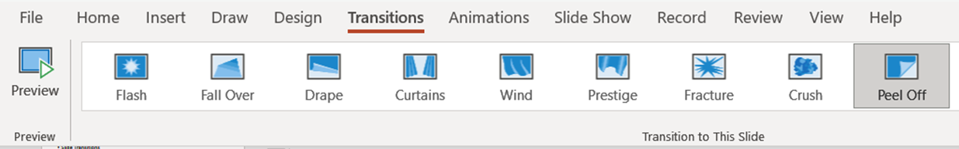
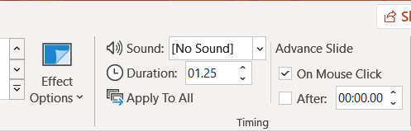

Transitions
Transition effect from one slide to next
Consistent transitions (recommended)
Apply to individual, selected, or all slides

Slide 15
Practice: Transitions
Select a transition for just this slide
After each change, preview the effect
Change transition effects, if any (left, right, up, down, etc)
Change the speed (duration) of the transition
Apply to all
Choose the “None” transition and apply to all

Slide 16
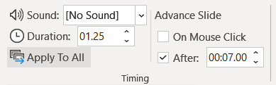
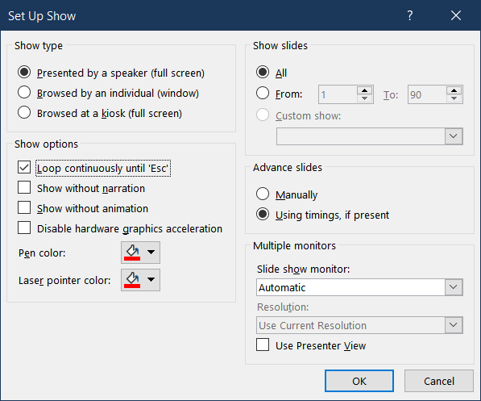
Practice: Transitions (self-running)
We won’t practice this in class, but you can try this on your own
  From transition menu, Choose “Advance Slide, After, and the amount of time between each slide.
  Set Up Slide Show, Loop Continuously, Using timings
  (Slide Show Menu)

Slide 17
Animations
Any object can be made to appear or disappear in a sequence
Anything you don’t animate appears first
Bullet boxes by default sequence one bullet after another on a mouse click or slide advance
Multiple animations can be added to any object
Use Animation Pane to fine tune preferences

Slide 18
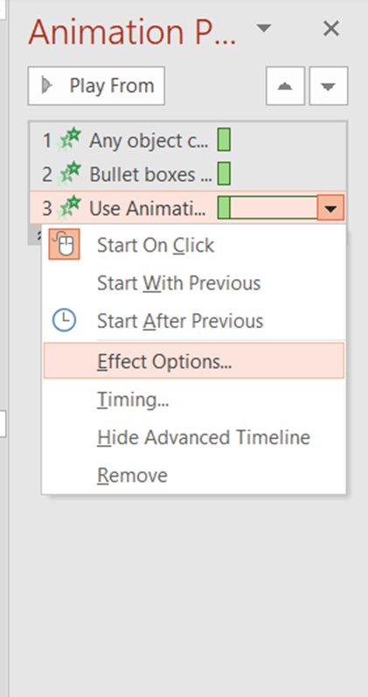
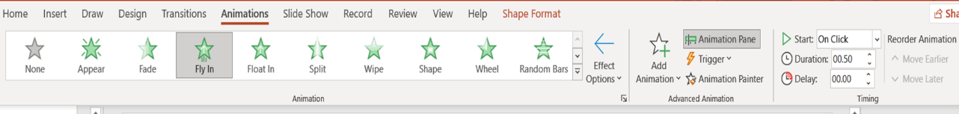
Animations
Select object(s) to animate
Select effect
Choose timing controls
Animation Pane
  Detailed controls
  Reorder timing

Slide 19
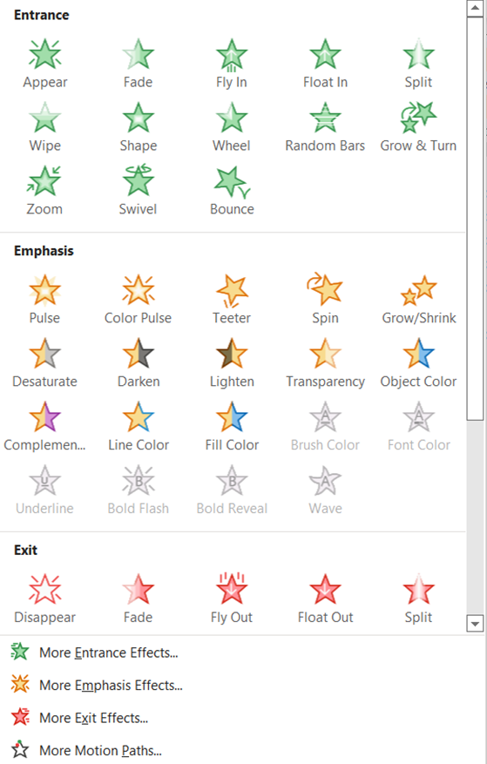

Animations
Multiple animations for same object
Select object
From animation menu select “Add Animation”
Choose new animation type (for example, “disappear”)
Fine tune timing/effects from Animation Pane

Slide 20

Practice: Animations
Animate this Bullet Box
Animate the graphic object.
Use Animation Pane to reorder the animations
Use Animation Pane to explore and change some of the animation effects
Add a second animation to the graphic object to make it disappear

