Slide 1
PowerPoint:
What’s the point?
Tools and Tips #3
For More Effective Teaching
Practice Slides
ICL Fall 2024
Read Gilgen

Slide 2

Hands on Exercises #3
Note: you can jump directly to the practice slide, but some instructional slides precede them, if you need review.
Tip: Click the “Slide Show” icon at the lower right to preview an edited slide
Tip: While experimenting, don’t forget Ctrl+Z (Undo)
Explore Shapes/Icons/etc. (#5)
Find/insert images from the web (#7)
Capture screen shots (#9)
Modify/Format graphic images/shapes (#12)
Combine images/shapes/text (#15)

Slide 3

Graphics Sources
Copyright issues
Searching vs. Browsing
  Search for what you need
  Don’t let available images alter your content

Slide 4
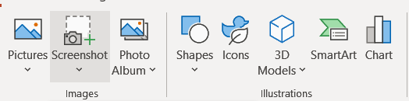

Graphics Sources
Illustrations (PPt/Built In)
  Shapes
  Icons
  Charts
Images
  From web pages (right-click/copy image)
  images.google.com
  Screen shots (Insert/Screenshot, or PrtScrn)
Photos
  From your own collection

Slide 5
Practice: shapes, icons, etc.
Insert different types of shapes, icons, etc. Experiment: Reposition, size, and layer them.

Slide 6
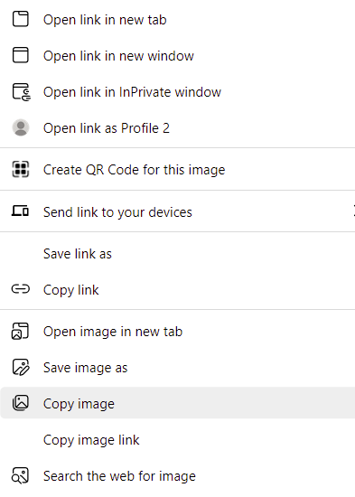
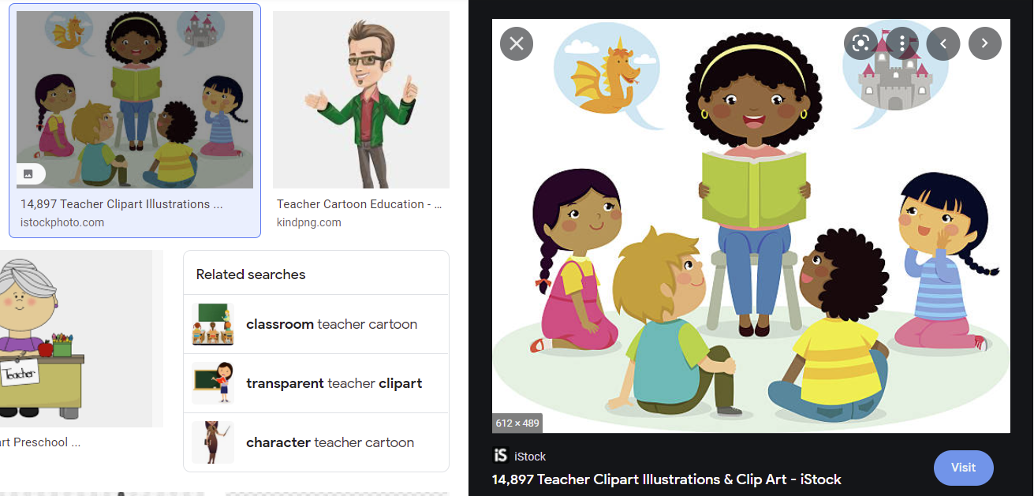
Graphics Sources: images.google.com

Slide 7
Practice: Images from the web
Open a web browser and go to images.google.com. Find and copy an image and paste in this slide.

Slide 8
Graphics: Screen Shots
Create blank slide with blank layout
Capture screen using Print Screen (PrtScrn)
  Alt-PrtScrn for active window only
  Menu/Insert/Screenshot/Screen Clipping for a specific portion of screen
Paste screen shot on blank slide
Size to fill entire slide or Crop as needed
Add annotations as needed
R

Slide 9
Practice: Screen shots
Take a screen shot of this screen (PrtScrn), paste it, and crop to just a portion of it.
Open a web browser, find a site, return here Insert Screenshot using the screen clipping tool.
Resize/reposition resulting images.

Slide 10
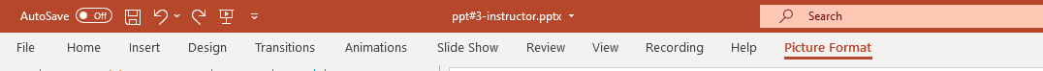

Modify Graphic Images

Slide 11
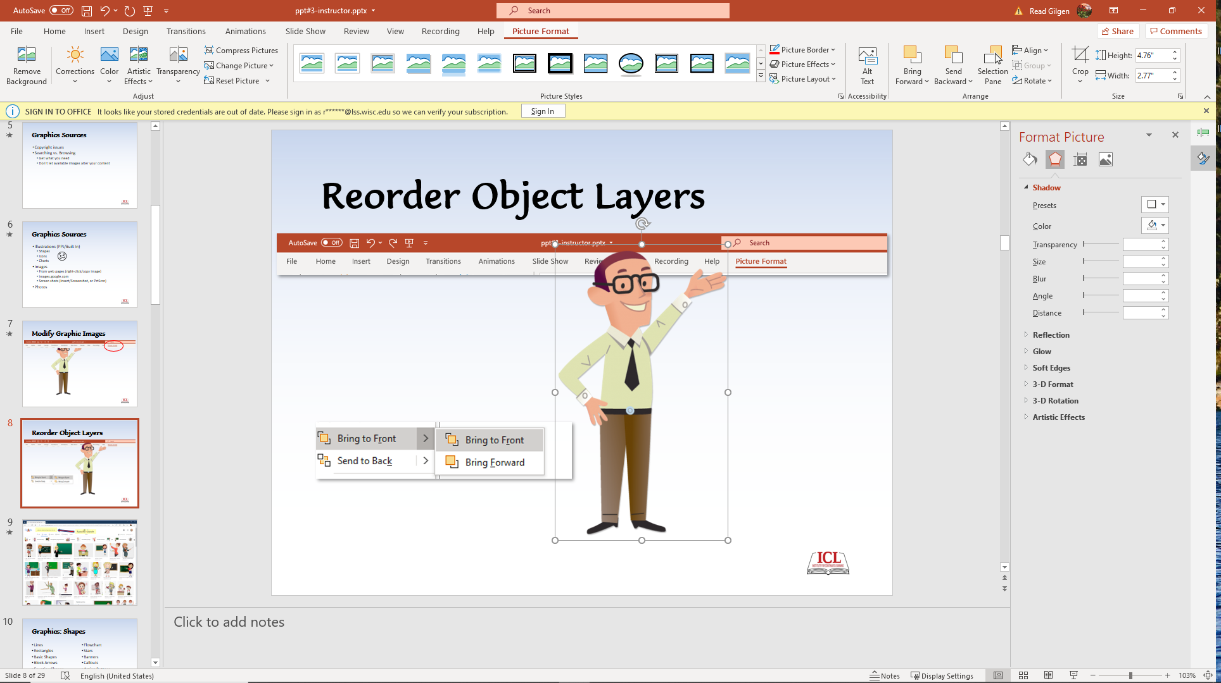
Picture Format
Adjust image
  Brightness/contrast
Picture styles
  Borders, effects
Arrange
  Object layers, alignment, rotate/flip
Size/cropping

Slide 12

Practice: Modify
Graphic Images
Drag corner: proportional sizing
Drag side or top: wider or taller
Drag side across to flip
Ctrl+drag: copy to a new location
Picture Format Menu: experiment with some of the options

Slide 13


Combining Graphic/Text Objects
¡Bienvenidos!

Slide 14


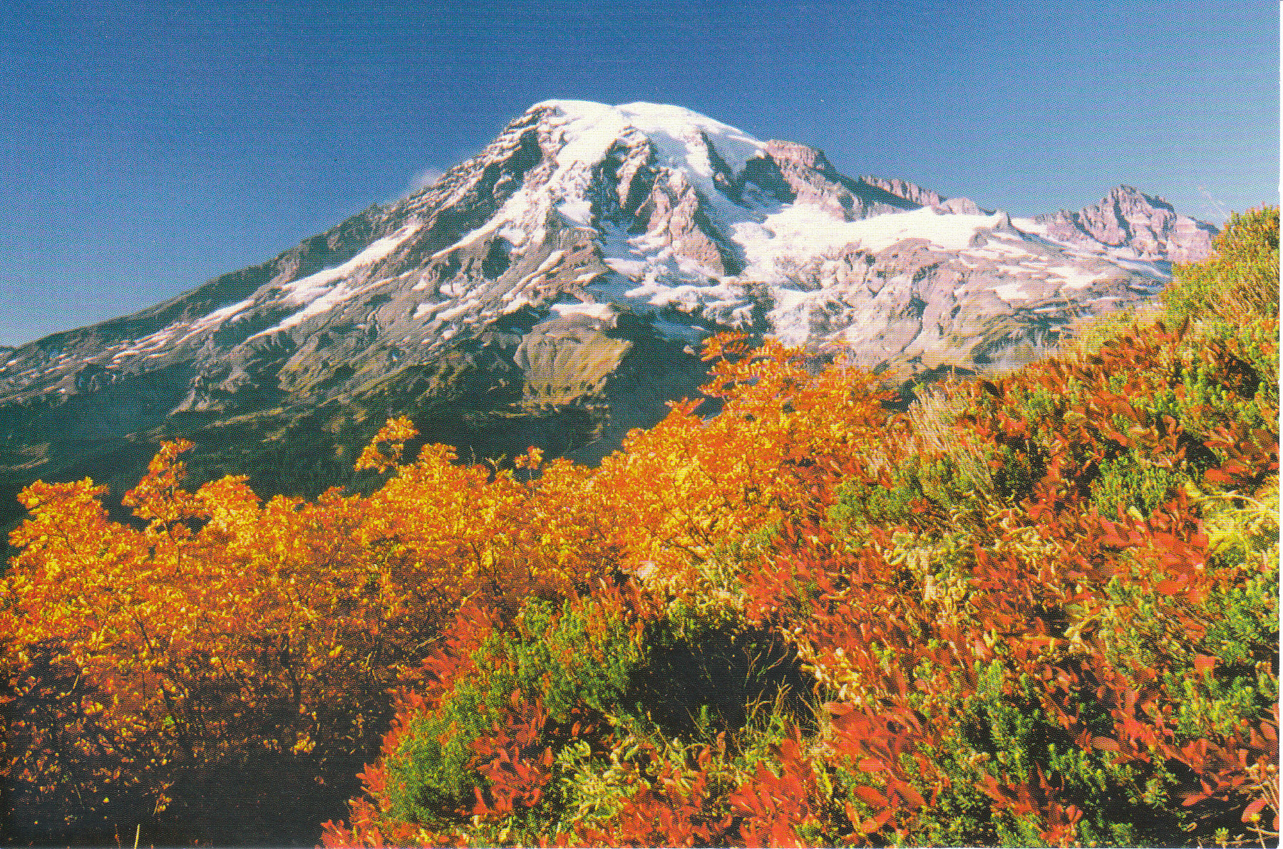
Practice Slides Resources
If you need some quick resources to practice with on next slide, you can copy and past these objects.
Or create or insert your own objects.
“Good enough is
good enough!”
Listen to what I’m telling you!

Slide 15
Practice: Combine Graphic/Text Objects
Add objects to slide: Clip art, Shapes, Text boxes
Resize and Position/Layer the objects
Group objects if needed
Animate as desired

