Slide 1
PowerPoint:
What’s the point?
Tools and Tips #4
For More Effective Teaching
Practice Slides
ICL Fall 2024
Read Gilgen

Slide 2

Hands on Exercises
Note: you can jump directly to the practice slide, but some instructional slides precede them, if you need review.
Tip: Click the “Slide Show” icon at the lower right to preview an edited slide
Tip: While experimenting, don’t forget Ctrl+Z (Undo)
Find and download audio from the internet (slide 5)
Insert Audio and Video (slide 10)
Trim Video (slide 13)
Playback options (slide 15)
Combine graphics and media (slide 17)

Slide 3
Sources for Software
Search web by subject for MP3 (audio) or MP4 (video)
  Your favorite browser and search engine
Express CD Ripper
  Free at https://express-rip-cd-ripper.en.softonic.com
Audacity
  Free at https://www.audacityteam.org/download/
4K Video Downloader (for YouTube, TikTok, etc)
  Free, or $15 Personal (one year license)
  $25 perpetual license (no ads, unlimited downloads, one time purchase)
  $15 one-time cost, for one year/$25 perpetual license
  Get at: https://www.4kdownload.com/ (Caution: 4Kdownloader.com is scam site!)

Slide 4



Audio Sources
File types (.MP3, .WAV, …)
Search the web
Your own music collection (MP3 files)
  “Rip” from CDs (Express Rip CD Ripper)
Record Audio (Insert/Audio/Record Audio)
Audacity for Editing

Slide 5
Practice: Find/Download from Web
Search web for a sound effect in MP3 format (audio) and download it. You’ll use this later.
Caution: Make sure what you’re clicking on to download. Many sites have “Ads” that include a download button, but for their software, not for the file you want.

Slide 6

Video Sources
Some websites have videos that can be downloaded
  Try to find/use .MP4 format videos
  Remember copyright issues (no Disney videos!)

Slide 7
Video Sources
YouTube: Largest collection of videos (& Audio)
  Search for specific topics
  Can’t download directly from YouTube
  You can play directly from YouTube:
  https://www.youtube.com/watch?v=oMoymqXB4Cs
    But you have to leave PowerPoint
    You get whatever YouTube plays (e.g., ads)
YouTube Downloader
  Creates usable MP4 video files
  Embed video in PowerPoint
  Recommended: 4KDownloader
    4Kdownload.com (Caution: 4Kdownloader.com is a scam site!)

Slide 8
Media Insert/Link/Action
Insert (preferred)
  Shows Icons/Thumbnails & Controls
Link (not recommended)
  Opens separate external program to play
Action (specific/limited uses)
  Linking options
  Plays directly only .WAV sounds

Slide 9
Already downloaded media files
BeethovenMinuet.mp3
(The MP3 audio file you downloaded earlier)
HakunaMatata.mp4
ThatsAllFolks.mp4
TheUnitedStatesConstitutionandBillofRights.mp4 (YouTubeVideo)
Note: It’s always a good idea to place your media files in the same folder as your PowerPoint show.

Slide 10


Practice: Insert Audio/Video
Insert Menu
Audio (audio on my PC)*
Video (this device)*
Reposition/resize icons
Play this slide and control
the media (play, pause,
volume, skip forward)
* See the previous slide for files you have on your computer.

Slide 11
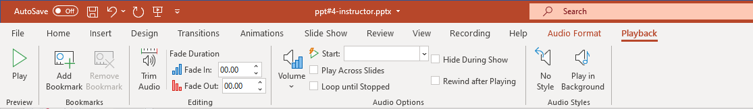
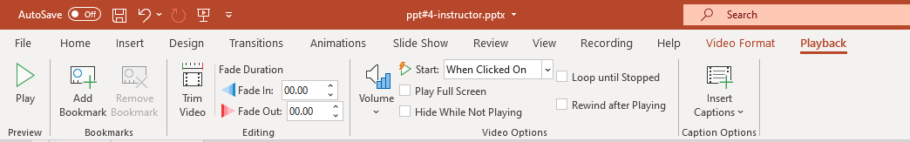
Audio
Playback Options
Video

Slide 12
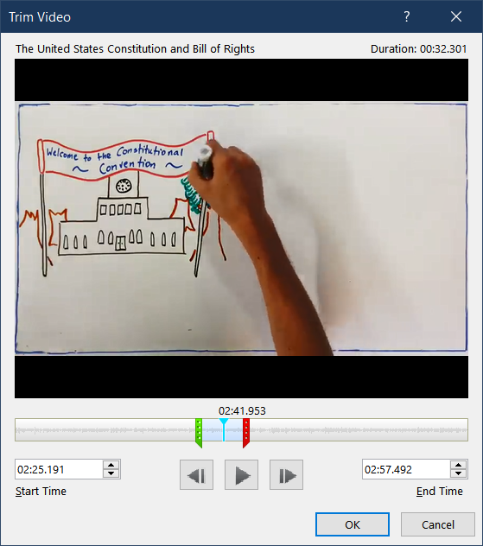
Trim Video/Audio
Select media to be trimmed
From Playback menu, choose Trim Video (or Audio)
Move sliders to denote start/end times
Type in exact start/end times

Slide 13

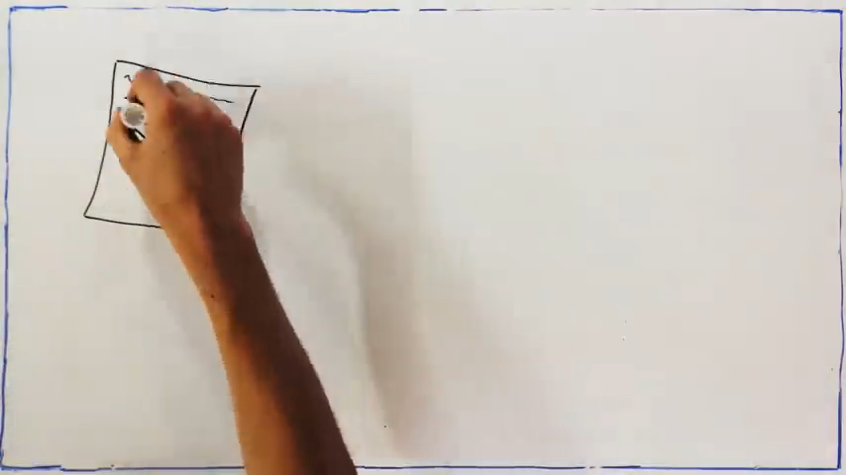
Practice: Trim Media
Select media to be trimmed
From Playback menu, choose Trim Video (or Audio) using sliders or exact times
Play this slide to see the results

Slide 14

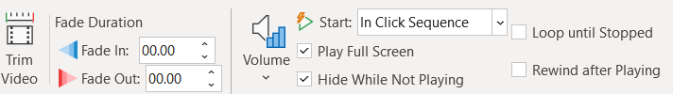
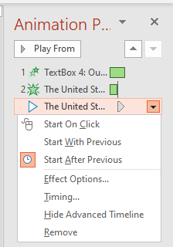
YouTube Video
Our U.S. Constitution

Slide 15
Practice: Playback Options
Our U.S. Constitution
Select video and go to Playback options
Choose to Start In click sequence,
Play full screen
In Animation pane, adjust the sequence for playing the video, either on click, or “with” a previous animation
Play this slide to test the results
Try other options

Slide 16

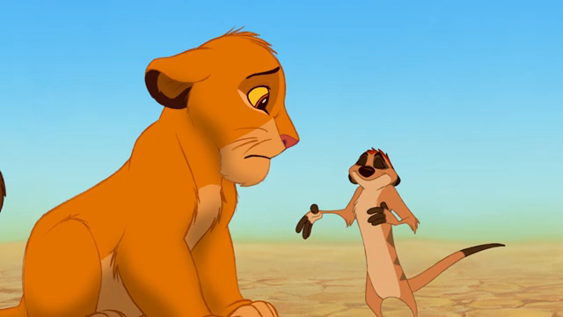

Combined Graphics & Media
Audio/ Music
Video

Slide 17
Combined Graphics & Media
Video
Audio/ Music
See Slide Notes for steps/instructions.
Notes:
Insert HakunaMatata Video: resize to fit over film image. Trim (playback) to 34 seconds
Insert Beethoven Audio: resize to cover violin image; format picture, picture, transparency to 100% / Audio Format, Corrections, Picture Corrections Options, Transparency to 100%
Animation pane: remove animations for playback or else these will play automatically when you click/advance
Test it

